Slide 1
Finite State Machine based Morphology

Slide 2
Background
The problem of recognizing that foxes breaks down into the two morphemes fox and -es is called morphological parsing.
Similar problem in the information retrieval domain: stemming
Given the surface or input form going, we might want to produce the parsed form: VERB-go + GERUND-ing
In this chapter
morphological knowledge and
The finite-state Machine
It is quite inefficient to list all forms of noun and verb in the dictionary because the productivity of the forms.
Morphological parsing is necessary more than just IR, but also
Machine translation
Spelling checking

Slide 3
Survey of (Mostly) English Morphology
Morphology is the study of the way words are built up from smaller meaning-bearing units, morphemes.
Two broad classes of morphemes:
The stems: the “main” morpheme of the word, supplying the main meaning, while
The affixes: add “additional” meaning of various kinds.
Affixes are further divided into prefixes, suffixes, infixes, and
circumfixes.
Suffix: eat-s
Prefix: un-buckle
Circumfix: ge-sag-t (said) sagen (to say) (in German)
Infix: hingi (borrow) humingi (the agent of an action) )in Philippine language Tagalog)

Slide 4
Survey of (Mostly) English Morphology
Prefixes and suffixes are often called concatenative morphology.
A number of languages have extensive non-concatenative morphology
The Tagalog infixation example
Templatic morphology or root-and-pattern morphology, common in Arabic, Hebrew, and other Semitic languages
Two broad classes of ways to form words from morphemes:
Inflection: the combination of a word stem with a grammatical morpheme, usually resulting in a word of the same class as the original tem, and usually filling some syntactic function like agreement, and
Derivation: the combination of a word stem with a grammatical morpheme, usually resulting in a word of a different class, often with a meaning hard to predict exactly.

Slide 5
Survey of (Mostly) English Morphology
Inflectional Morphology
In English, only nouns, verbs, and sometimes adjectives can be inflected, and the number of affixes is quite small.
Inflections of nouns in English:
An affix marking plural,
cat(-s), thrush(-es), ox (oxen), mouse (mice)
waltz(-es), box(-es), butterfly(-lies)

Slide 6
Survey of (Mostly) English Morphology
Inflectional Morphology
Verbal inflection is more complicated than nominal inflection.
English has three kinds of verbs:
Main verbs, eat, sleep, impeach
Modal verbs, can will, should
Primary verbs, be, have, do
Morphological forms of regular verbs
stem | walk | merge | try | map
-s form | walks | merges | tries | maps
-ing principle | walking | merging | trying | mapping
Past form or –ed participle | walked | merged | tried | mapped
– These regular verbs and forms are significant in the morphology of English because of their majority and being productive.

Slide 7
Survey of (Mostly) English Morphology
Inflectional Morphology
– Morphological forms of irregular verbs
stem | eat | catch | cut
-s form | eats | catches | cuts
-ing principle | eating | catching | cutting
Past form | ate | caught | cut
–ed participle | eaten | caught | cut

Slide 8
Survey of (Mostly) English Morphology
Derivational Morphology
Nominalization in English:
– The formation of new nouns, often from verbs or adjectives
Suffix | Base Verb/Adjective | Derived Noun
-action | computerize (V) | computerization
-ee | appoint (V) | appointee
-er | kill (V) | killer
-ness | fuzzy (A) | fuzziness
– Adjectives derived from nouns or verbs
Suffix | Base Noun/Verb | Derived Adjective
-al | computation (N) | computational
-able | embrace (V) | embraceable
-less | clue (A) | clueless

Slide 9
Survey of (Mostly) English Morphology
Derivational Morphology
Derivation in English is more complex than inflection because
Generally less productive
A nominalizing affix like –ation can not be added to absolutely every verb.
eatation(*)
There are subtle and complex meaning differences among nominalizing suffixes. For example, sincerity has a subtle difference in meaning from sincereness.

Slide 10
Finite-State Machine Morphological Parsing
Parsing English morphology
Input | Morphological parsed output
cats cat | cat +N +PL cat +N +SG
cities | city +N +PL
geese goose | goose +N +PL (goose +N +SG) or (goose +V)
merging caught | merge +V +PRESENT-PARTICIPAL (caught +V +PAST-PARTICIPAL)

Slide 11
Finite-State Machine Morphological Parsing
We need at least the following to build a morphological parser:
Lexicon: the list of stems and affixes, together with basic information about them (Noun stem or Verb stem, etc.)
Morphotactics: the model of morpheme ordering that explains which classes of morphemes can follow other classes of morphemes inside a word. E.g., the rule that English plural morpheme follows the noun rather than preceding it.
Orthographic rules: these spelling rules are used to model the changes that occur in a word, usually when two morphemes combine (e.g., the y→ie spelling rule changes city + -s to cities).

Slide 12
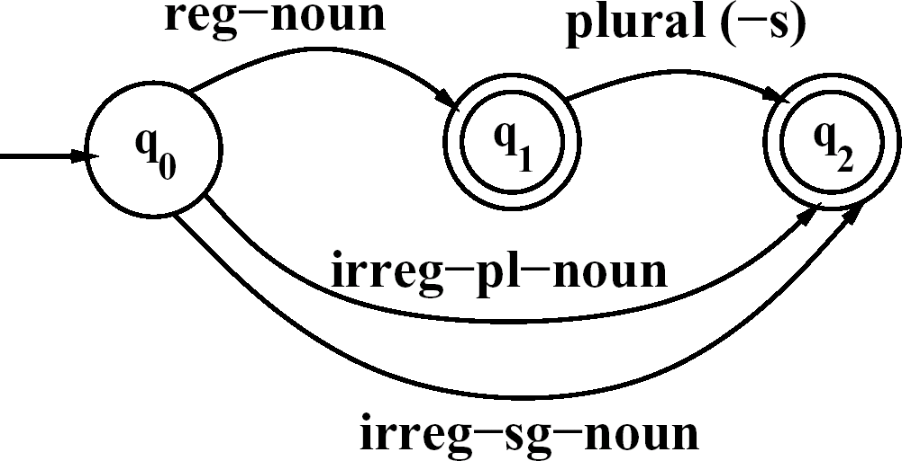
Finite-State Morphological Parsing
The Lexicon and Morphotactics
A lexicon is a repository for words.
The simplest one would consist of an explicit list of every word of the language.
Incovenient or impossible!
Computational lexicons are usually structured with
a list of each of the stems and
Affixes of the language together with a representation of morphotactics telling us how they can fit together.
The most common way of modeling morphotactics is the finite-state automaton.
Reg-noun | Irreg-pl-noun | Irreg-sg-noun | plural
fox fat fog | geese sheep Mice | goose sheep mouse | -s
fardvark
An FSA for English nominal inflection

Slide 13
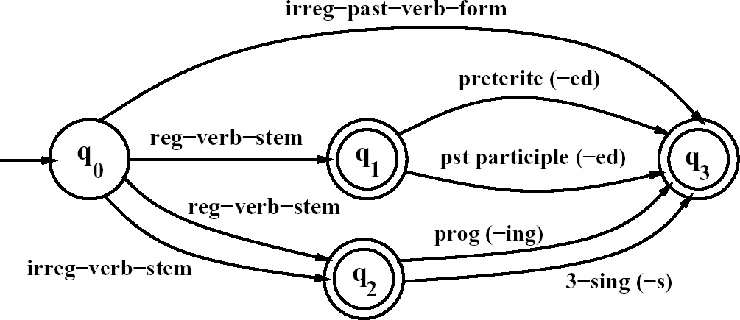
Finite-State Morphological Parsing
The Lexicon and Morphotactics
An FSA for English verbal inflection
Reg-verb-stem | Irreg-verb-stem | Irreg-past-verb | past | Past-part | Pres-part | 3sg
walk fry talk | cut speak sing | caught ate eaten | -ed | -ed | -ing | -s
impeach | sang spoken

Slide 14
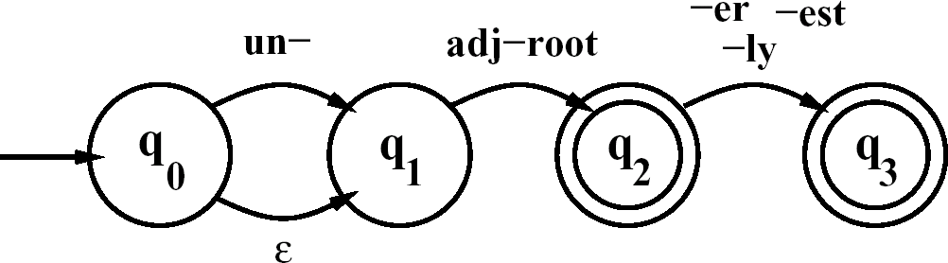
Finite-State Morphological Parsing
The Lexicon and Morphotactics
English derivational morphology is more complex than English inflectional morphology, and so automata of modeling English derivation tends to be quite complex.
– Some even based on CFG
A small part of morphosyntactics of English adjectives
big, bigger, biggest
cool, cooler, coolest, coolly red, redder, reddest
clear, clearer, clearest, clearly, unclear, unclearly happy, happier, happiest, happily
unhappy, unhappier, unhappiest, unhappily real, unreal, really
An FSA for a fragment of English adjective Morphology #1

Slide 15
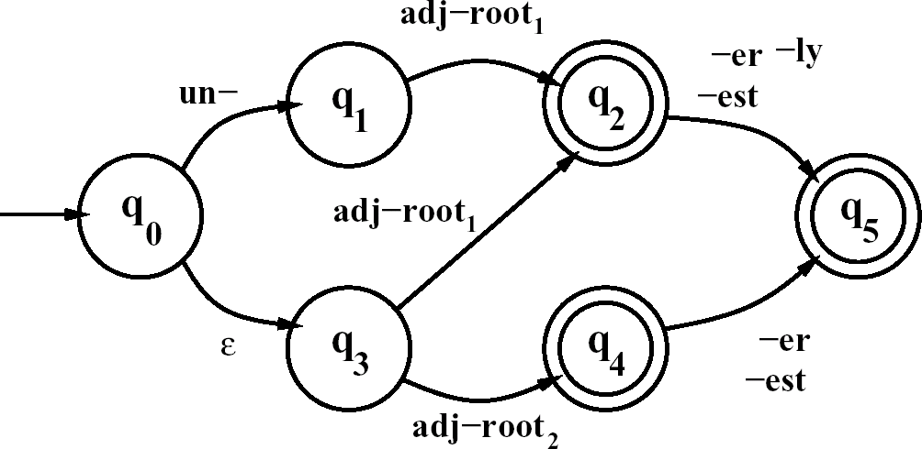
Finite-State Morphological Parsing
The FSA#1 recognizes all the listed adjectives, and ungrammatical forms like unbig, redly, and realest.
Thus #1 is revised to become #2.
The complexity is expected from English derivation.
An FSA for a fragment of English adjective Morphology #2

Slide 16
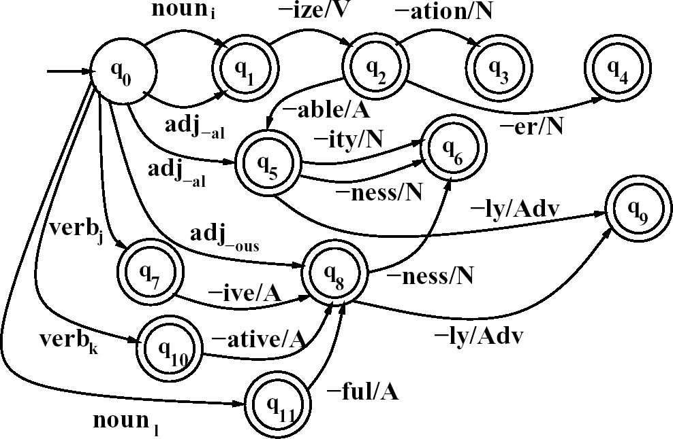
Finite-State Machine Morphological Parsing
An FSA for another fragment of English derivational morphology

Slide 17
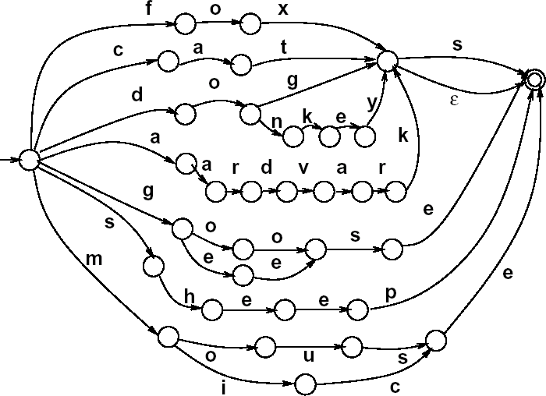
Finite-State Machine Morphological Parsing
We can now use these FSAs to solve the problem of morphological recognition:
Determining whether an input string of letters makes up a legitimate English word or not
We do this by taking the morphotactic FSAs, and plugging in each “sub-lexicon” into the FSA.
The resulting FSA can then be defined as the level of the individual letter.

Slide 18
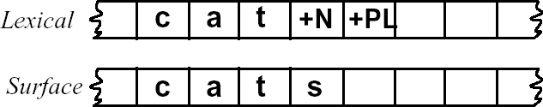
Finite-State Machine Morphological Parsing
Morphological Parsing with FSM
Given the input, for example, cats, we would like to produce cat +N +PL.
Two-level morphology, by Koskenniemi (1983)
Representing a word as a correspondence between a lexical level
Representing a simple concatenation of morphemes making up a word, and
The surface level
Representing the actual spelling of the final word.
Morphological parsing is implemented by building mapping rules that maps letter sequences like cats on the surface level into morpheme and features sequence like cat +N +PL on the lexical level.

Slide 19
Finite-State Machine Morphological Parsing
Morphological Parsing with FSM
The automaton we use for performing the mapping between these two levels is the finite-state Machine or FSM.
A transducer maps between one set of symbols and another;
An FSM does this via a finite automaton.
Thus an FSM can be seen as a two-tape automaton which recognizes or
generates pairs of strings.
The FSM has a more general function than an FSA:
An FSA defines a formal language
An FSM defines a relation between sets of strings.
Another view of an FSM:
A machine reads one string and generates another.

Slide 20
Finite-State Machine Morphological Parsing
Morphological Parsing with FSM
FSM as recognizer:
a transducer that takes a pair of strings as input and output accept if the string-pair is in the string-pair language, and a reject if it is not.
FSM as generator:
a machine that outputs pairs of strings of the language. Thus the output is a yes or no, and a pair of output strings.
FSM as transducer:
A machine that reads a string and outputs another string.
FSM as set relater:
A machine that computes relation between sets.

Slide 21
Finite-State Morphological Parsing
Morphological Parsing with FSM
A formal definition of FST (based on the Mealy machine extension to a simple FSA):
Q: a finite set of N states q₀, q₁,…, q_{N}
Σ: a finite alphabet of complex symbols. Each complex symbol is composed of an input-output pair i : o; one symbol I from an input alphabet I, and one symbol o from an output alphabet O, thus Σ ⊆ I×O. I and O may each also include the epsilon symbol ε.
q₀: the start state
F: the set of final states, F ⊆ Q
δ(q, i:o): the transition function or transition matrix between states. Given a state q ∈ Q and complex symbol i:o ∈ Σ, δ(q, i:o) returns a new state q’
∈ Q. δ is thus a relation from Q × Σ to Q.

Slide 22
Finite-State Morphological Parsing
Morphological Parsing with FSM
FSAs are isomorphic to regular languages, FSMs are isomorphic to
regular relations.
Regular relations are sets of pairs of strings, a natural extension of the regular language, which are sets of strings.
FSMs are closed under union, but generally they are not closed under difference, complementation, and intersection.
Two useful closure properties of FSMs:
Inversion: If T maps from I to O, then the inverse of T, T⁻¹ maps from O
to I.
Composition: If T₁ is a Machine from I₁ to O₁ and T₂ a Machine from
I₂ to O₂, then T₁ 。 T₂ maps from I₁ to O₂

Slide 23
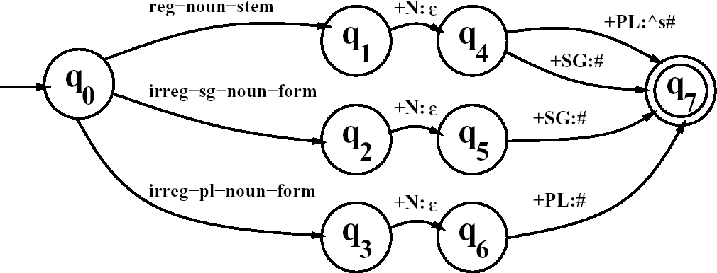
Finite-State Morphological Parsing
Morphological Parsing with FSM
Inversion is useful because it makes it easy to convert a FSM-as-parser into an FSM- as-generator.
Composition is useful because it allows us to take two transducers than run in series and replace them with one complex transducer.
– T₁。T₂(S) = T₂(T₁(S) )
Reg-noun | Irreg-pl-noun | Irreg-sg-noun
fox fat fog | g o:e o:e s e sheep m o:i u:εs:c e | goose sheep mouse
aardvark
A Machine for English nominal number inflection T_{num}

Slide 24
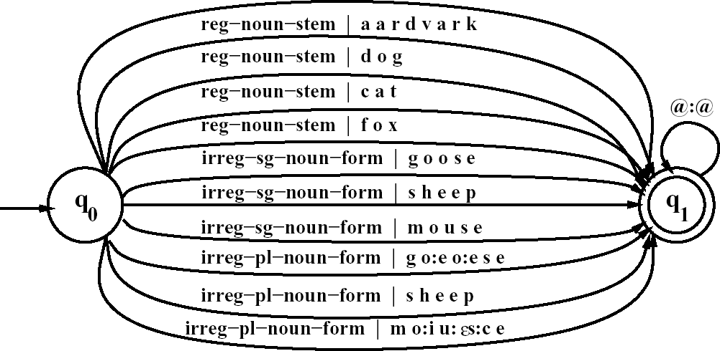
Finite-State Morphological Parsing
Morphological Parsing with FSM
The transducer T_{stems}, which maps roots to their root-class

Slide 25
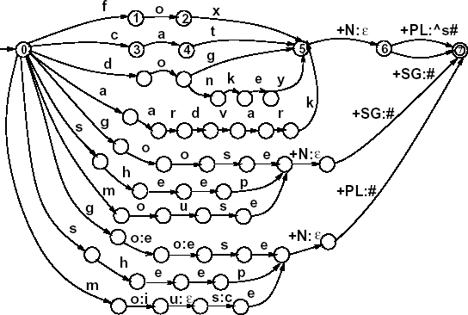
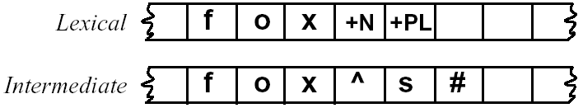
Finite-State Morphological Parsing
Morphological Parsing with FSM
^: morpheme boundary #: word boundary
A fleshed-out English nominal inflection FSM ^{T}lex ^{= T}num^{。T}stems

Slide 26
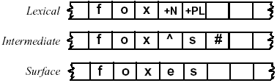
Finite-State Morphological Parsing
Orthographic Rules and FSM
Spelling rules (or orthographic rules)
Name | Description of Rule | Example
Consonant doubling E deletion E insertion | 1-letter consonant doubled before -ing/-ed Silent e dropped before -ing and -ed e added after -s, -z, -x, -ch, -sh, before -s | beg/begging make/making watch/watches
Y replacement K insertion | -y changes to -ie before -s, -i before -ed Verb ending with vowel + -c add -k | try/tries panic/panicked
– These spelling changes can be thought as taking as input a simple concatenation of morphemes and producing as output a slightly-modified concatenation of morphemes.

